Slide 1
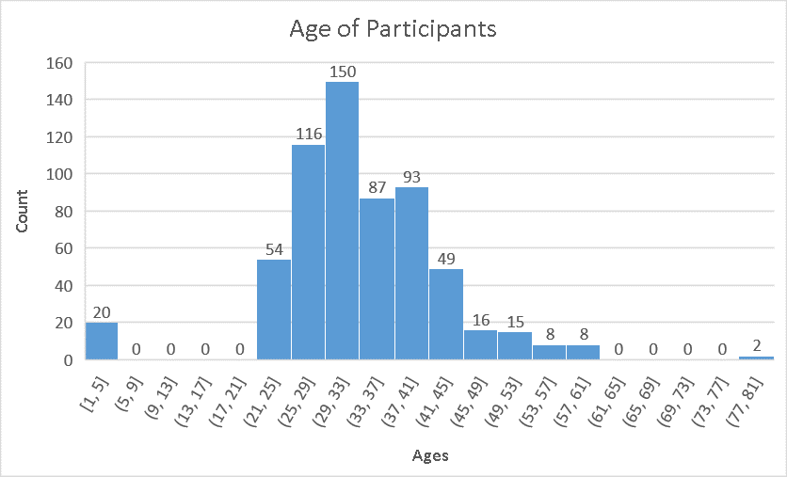
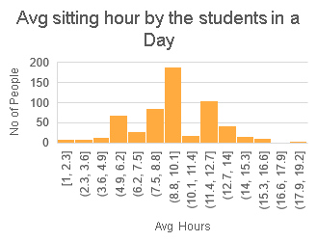
WHAT IS THE AGE OF ENROLLED SURVEY PARTICIPANTS IN UDACITY WITH COMPARSION TO AVG SITTING BY STUDENT IN A DAY??
Measure | Value
mean | 33.91691
median | 32.83151
Mode | 37.80822
Std_Dev | 9.688868
Range | 78
Measure | Value
mean | 13.79918
median | 10
mode | 10
Std_Dev | 49.80728
range | 17
Here, Students with avg(mean) 34 years are want to enrolled in udacity with the avg sitting of around 13.8 years per day. Maximum(mode) number of students who wanted to join the udacity program of 38 years old. Students with the age around 33 years lies somewhat middle(median) in our data, which indicates mostly students are from this age group only. Range is 78 years indicating that it covers almost every age that want to join udacity that is it is spread more as per certain outliners.
Atlast, Std_Dev of age is around 10 years with the Std_dev of avg sitting by students is 50 hours indicating that age group data is less spread over the graph as compared to standard deviation of avg sitting. (Standard deviation value showcase the value, that is how much it is deviating from the mean value). So, we also say that the graph fro avg sitting graph is more spreaded than the age of participants graph
*Result are Limited to Survey Participants

Slide 2
WHAT WAS MOST HELPFUL WHEN STUDENTS GOT STUCK IN THE NANODEGREE PROGRAM(S)?
What was most helpful when you got stuck in the Nanodegree program(s)? | Count of What was most helpful when you got stuck in the Nanodegree program(s)?
Ask Me Anythings (AMAs) | 4
Forums | 323
Live Help | 9
Mentor Help (classroom or 1:1 mentors) | 40
Slack Channel | 173
Stack Overflow | 142
If I go with the facts, it says forums are the most helpful and live help the least. And it is right to say because, it has some genuine question and answers which is relevant to our nanodegree.
*Result are Limited to Survey Participants

Slide 3
WHAT ARE SOME OF THE NANODEGREE PROGRAM THAT THE STUDENTS ARE INTERESTED IN?
Nanodegrees | Count
Intro To Programming | 23
Business Analyst | 19
Data Analyst | 157
Machine Learning | 235
Artificial Intelligence | 111
Deep Learning | 291
Self Driving Car | 15
Robotics | 8
Here I found that students are mostly interested in Deep Learning Foundation. As our current trend is moving towards Artificial intelligence, Students found Deep Learning to be an important learning tool before learning Artificial Intelligence.
*Result are Limited to Survey Participants

Slide 4
AFTER COMPLETING THEIR RESPECTIVE EDUCATION, HOW MANY YEARS OF EXPERIENCE PEOPLE ARE WILLING TO TAKE THE NANODEGREES???
What is your highest level of education? | Years of experience in Job | Count of People
Associates | 117 | 12
Bachelors | 1552 | 283
High school or below | 120 | 24
Masters | 2332 | 316
Nanodegree Program | 249 | 45
PhD | 602 | 73
So, mostly bachelors are willing to take the nanodegrees with more 1500 years of cumulative experience. Experience of each bachelor will be around 5-6years.And the least wiliness are shown by associates with an average experience of 9-10 years.
*Result are Limited to Survey Participants

Slide 5
CONCLUSION
After studying the survey data, I can conclude that students with avg of 34 years want to join udacity as compared any other age group and this age group is tempted more to sit in a day with an avg of 13.8 hours. Forums are the best helpful source for the nanodegree students. Mostly Students are interested in Deep Learning Foundation nanodegree. Bachelors the kind of people that are mostly interested in the udacity Nanodegree with an avg of 5-6 years in job Experience
*Result are Limited to Survey Participants

